Slide 1
Week 9, Lecture 2
Files (contd)

Slide 2
This week’s topics
Files concepts (Chapter 13: sec. 1, Tutorial: File I/O)
File handling classes (Chapter 13: sec. 2-4, Tutorial: File I/O)
Stream handling classes (Chapter 13: sec. 3-4, Tutorial: I/O streams)
Random access files (Chapter 13: sec. 6-7, Tutorial: File I/O)
Reading material:
Chapter 13 of the textbook (a bit disorganised)
Java tutorial on I/O
https://docs.oracle.com/javase/tutorial/essential/io/index.html

Slide 3
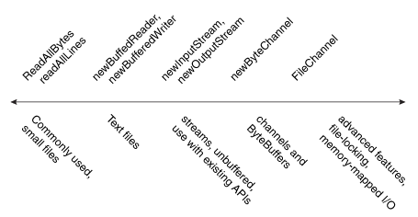
Many ways of working with files (Java tutorial)
1
2
3

Slide 4
Input/Output Streams

Slide 5
Streams
We have looked at Reader/Writer classes.
Streams are a generalisation of the concept.
In an input stream,
You have a “has next” method, that checks whether any more data is present.
You have a “next” method, that gives you the next piece of data.
In an output stream,
You have a “write” method, that outputs a data element on the stream.
All of them have “close” methods.
Buffered versions have “flush” methods.

Slide 6
Stream classes
InputStream / OutputStream
Meant for reading or writing bytes (8-bit memory units)
Reader / Writer
Meant for reading or writing characters (in any supported character set)
Scanner / PrintWriter / PrintStream
Meant for reading or writing strings
DataInputStream / DataOutputStream
Meant for reading or writing data values (int, float, char, boolean etc.)
ObjectInputStream / ObjectOutputStream
Meant for reading or writing entire objects (of Java classes)
These classes need to implement serializable interface.

Slide 7
Layering of stream classes (“filters”)
The stream classes are designed to be layered.
A higher-level stream class can be layered on top of a lower-level stream class.
Called “filters” in Java lingo.
You can also extend it by adding your own layers too (needs ingenuity).
File
InputStream
Reader
Scanner
bytes
characters
strings
File
InputStream
DataInputStream
bytes
data values

Slide 8
Examples of layering
Scanner s = new Scanner(
new BufferedReader(
new FileReader(“data.txt”)));
Scanner s = new Scanner(
new BufferedReader(
new InputStreamReader(
new FileInputStream(“data.txt”))));
DataInputStream s = new DataInputStream(
new FileInputStream(“data.txt”)));

Slide 9
More examples of layering
PrintStream
OutputStream
File
strings
bytes
PrintStream s = new PrintStream(
new FileOutputStream(“output.txt”)));
For example, instead of printing to System.out (which is a PrintStream), you can print to an arbitrary PrintStream variable, say myOut. Then you can assign to myOut, a PrintStream like this one. Your printings then go into the file “output.txt”.
See Figure 13-21 in the textbook for an example program.

Slide 10
Object I/O (advanced topic)
ObjectInputStream and ObjectOutputStream allow arbitrary objects to be written into files and read back.
So you can write entire data structures into files: e.g., Linked Lists, Binary Trees etc.
To do this, the class of the object must say
public class XYZ implements Serializable { … }
No code needs to be written for “Serializable”. Java will do it for you automatically!
When you read it back (using in.readObject), you must cast it to the right class.

Slide 11
Summary
Streams represent a framework in Java for layering data formats for Input/Output.
You can create stream objects that wrap files, and then process them in different ways.

Slide 12
Random access files
ByteChannel I/O

Slide 13
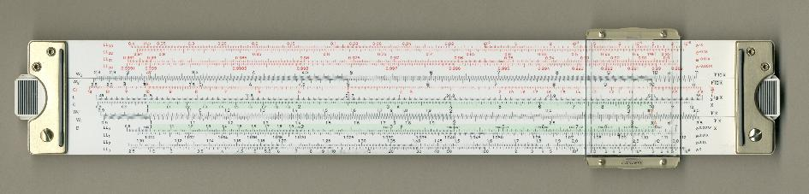
Byte Channel view of a file
The idea is to think of a file as a sequence of bytes. This is called a ByteChannel.
On this sequence, we place a window called a ByteBuffer.
The ByteBuffer is essentially an array of bytes. So we can read it as well as write into it. Ergo, we can read and write any part of the file.

Slide 14
The idea of “buffers” -1
A buffer allows programs or devices to communicate data to one another.
A put operation writes a new value into the buffer at position and advances it. The limit is set to the final value of position. (“relative put”)
A get operation reads the value at position and advances it. When it reaches limit, the ‘getting’ is finished. (“relative get”)
position
limit

Slide 15
The idea of “buffers” - 2
That means, position is the place where the next read or write into the buffer should happen.
Simlarly, limit is the place from which buffer contains no valid data.
position
limit

Slide 16
Java’s Buffer classes
A Buffer in Java adds two more indices into a sequence. (The sequence itself is not part of the Buffer; only the indices.)
In addition to get and put, some more operations are relevant:
clear: Needed at the start of a channel read. Also, the start of a put cycle.
Sets the position to 0 and limit to the capacity.
flip: Needed at the start of a channel write. Also, the start of a get cycle.
Sets the limit to the current position, and position to 0.
rewind: Needed at the start of renewed get cycle.
Sets the position to 0, leaves limit unchanged.
mark
position
limit
capacity

Slide 17
ByteBuffer
ByteBuffer is a Buffer on a sequence of bytes.
For reading a channel, we create a ByteBuffer that acts as a window (without its own data):
ByteBuffer readBuffer = ByteBuffer.allocate(capacity);
. . .
channel.read(readBuffer);
For writing to a channel, we create a ByteBuffer on an actual array of bytes:
ByteBuffer writeBuffer = ByteBuffer.wrap(byte-array);
. . .
channel.write(writeBuffer);

Slide 18
Sample code for reading (from Java tutorial)
try (ByteChannel channel = Files.newByteChannel(file)) {
ByteBuffer buffer = ByteBuffer.allocate(10);
// Read the bytes with the proper encoding for this platform.
String encoding = System.getProperty("file.encoding");
Charset charset = Charset.forName(encoding);
while (channel.read(buffer) > 0) {
buffer.rewind();
System.out.println(charset.decode(buffer) + "$");
buffer.flip(); // Not really needed in this case
}
}
catch (IOException e) {
System.out.println("something went wrong: " + e);
}

Slide 19
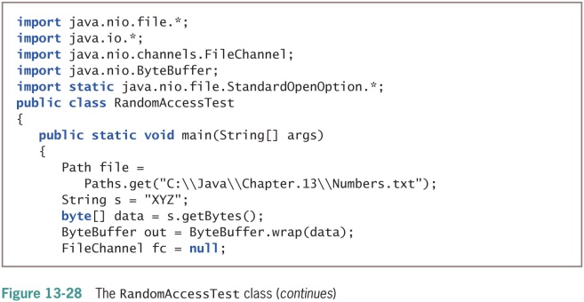
Sample code for writing (from Chapter 13)
Create a byte array and enclose it in a ByteBuffer object.

Slide 20
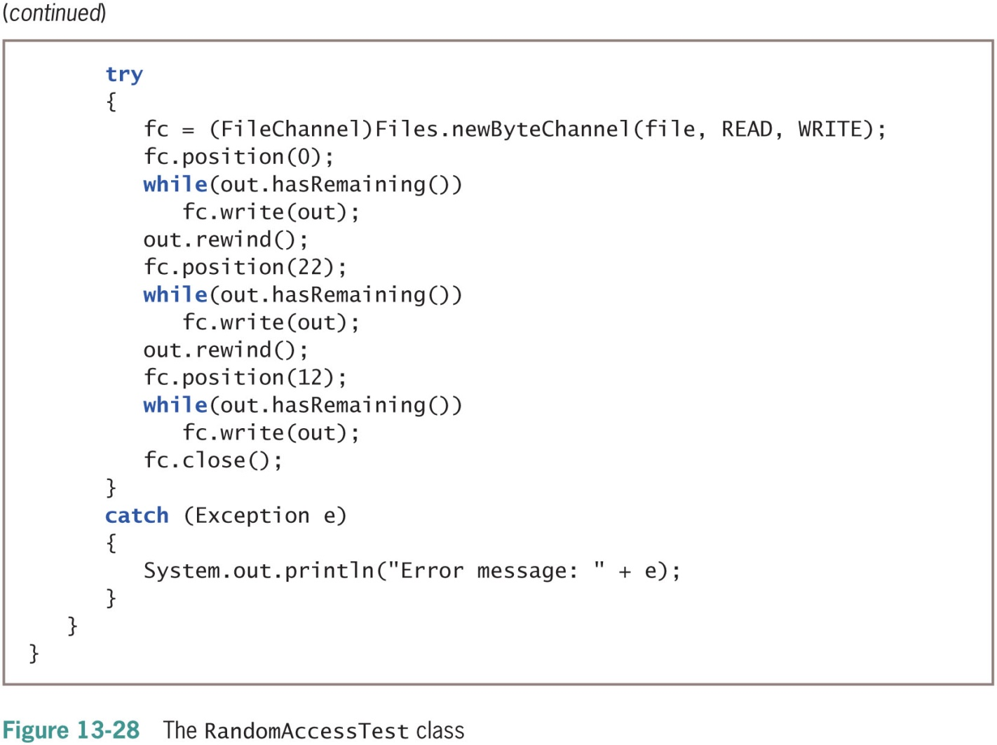
Sample code for writing (contd.)
Move to a particular position in the file and write the contents of the ByteBuffer there. (The same contents three times)

Slide 21
Standard Open Options
When you create a Reader/Writer, Stream or a Channel on a file, it implicitly carries out an ‘open’ operation.
What kind of opening should be done is specified through StandardOpenOptions (which are predefined constants).
import static java.nio.file.StandardOpenOption.*;
Examples:
READ – for reading
WRITE – for writing
CREATE – for creating a new file
CREATE_NEW – for creating a new file if it does not exist already

Slide 22
Summary
Streams represent a framework in Java for layering data formats for Input/Output.
You can create stream objects that wrap files and then process them in different ways.
Channels represent a framework for reading as well as writing files, through ByteBuffer windows.
Channels allow “random access”, i.e., read/write at any position the file.
Use StandardOpenOptions while creating any of these to specify what operations on the file are permissible.

